Slide 1








Internal Start Hack
1
Classification: INTERNAL USE ONLY

Slide 2




Introduction
What is sustainability
Balancing Act:
Sustainability maintains the delicate balance in Earth's ecosystems.
Wise Resource Use:
Essential for utilizing resources judiciously to ensure their longevity.
Guardianship Role:
Treats Earth as a friend, ensuring its well-being for current and future generations.
Environmental Harmony:
Reflects a commitment to keeping the world healthy, harmonious, and aesthetically pleasing.

Slide 3

About Application
Green Gaming Adventure:
Green Harvest turns sustainability into a fun game for an eco-adventure.
Learn and Play:
Test your eco-wisdom in an interactive way with friendly hints for guidance.
Your Pocket Green Guide:
The app helps you adopt green habits, making sustainability easy.
Become an Eco-Champion:
Unleash your inner environmental champion while having fun and learning for a brighter future!

Slide 4

Importance of Quiz
Unlocking Sustainable Wisdom:
"Unlock the importance of GreenHarvest quiz" signifies delving into the significance of sustainable living.
Cultivatin Eco-Awareness:
Each quiz stage cultivates a garden of sustainable wisdom, guiding users from land preparation to harvesting.
Beyond a Score:
In GreenHarvest, learning sustainability transcends a mere score; it's a journey of sowing seeds for a greener, brighter future.
Three Levels of Progress:
The game offers three progressive levels, increasing the challenge as we answer each question, ensuring a comprehensive exploration of eco-conscious topics.
Results for Impact:
Users receive results, not just scores, reflecting the impact of their newfound eco-awareness and knowledge.

Slide 5

Landing Page
Here firstly is our Intro Page where information and stages are present

Slide 6

Login and Registration Page
Then comes the login page for credentials

Slide 7

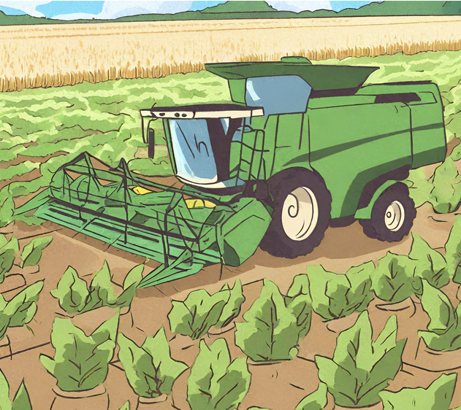
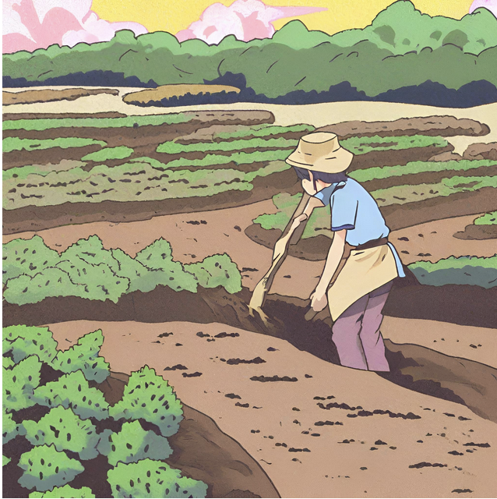

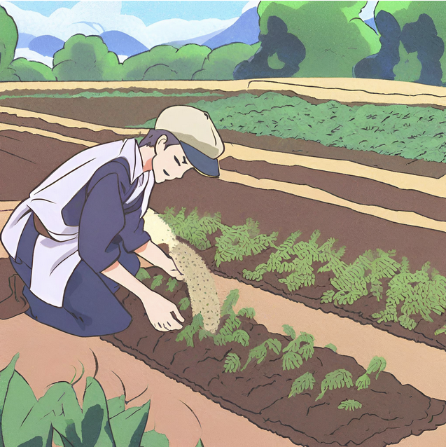
Stages of Quiz
Level 2
Planting & Monitoring – where you nurture your green expertise, sow seeds of environmental wisdom, and watch your sustainable know-how sprout to life!
Level1
Cultivate Knowledge, Plant Seeds of Sustainability, and Watch Your Eco-IQ Blossom!
Level 3
Cultivate Knowledge, Plant Seeds of Sustainability, and Watch Your Eco-IQ Blossom!

Slide 8
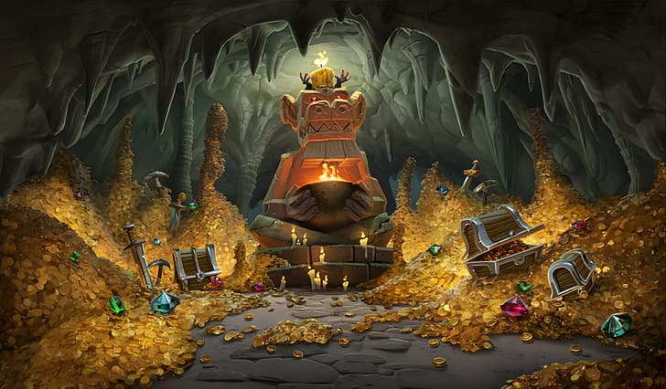
Rewards
After the game, the user can redeem the points to avail discounts at seeds.

Slide 9


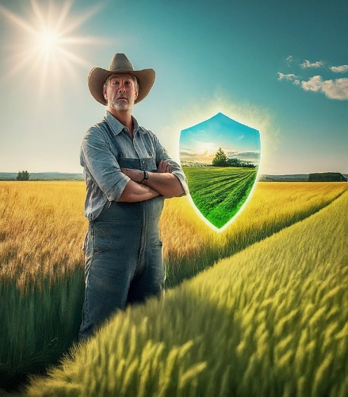
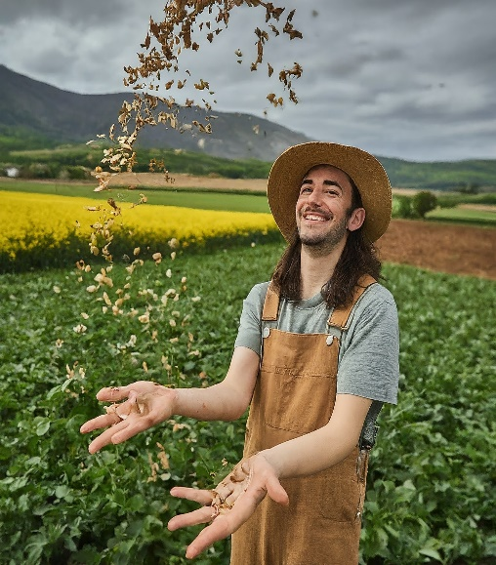
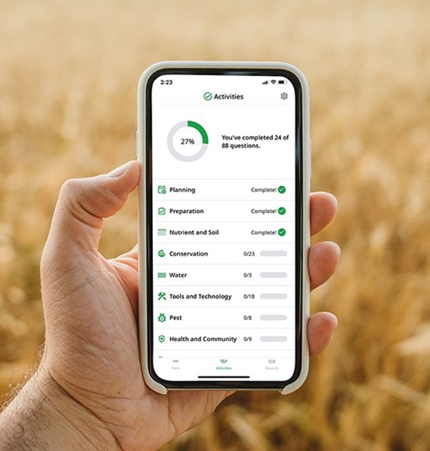

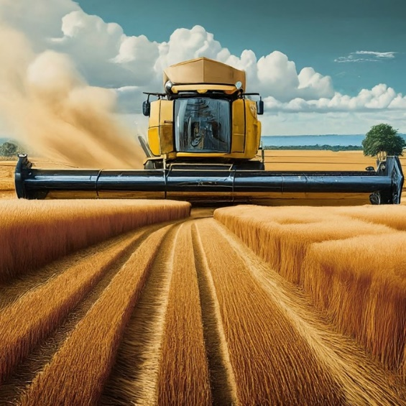
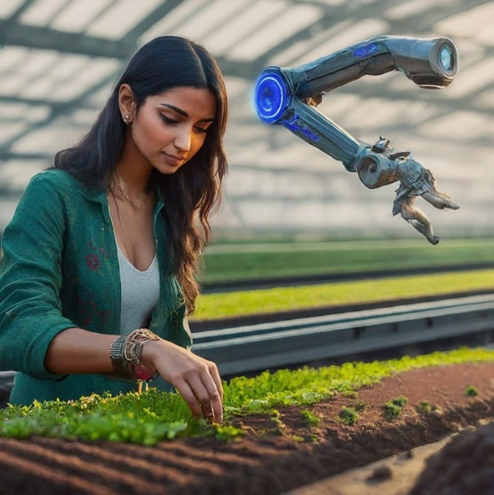

Thank You

